Slide 1
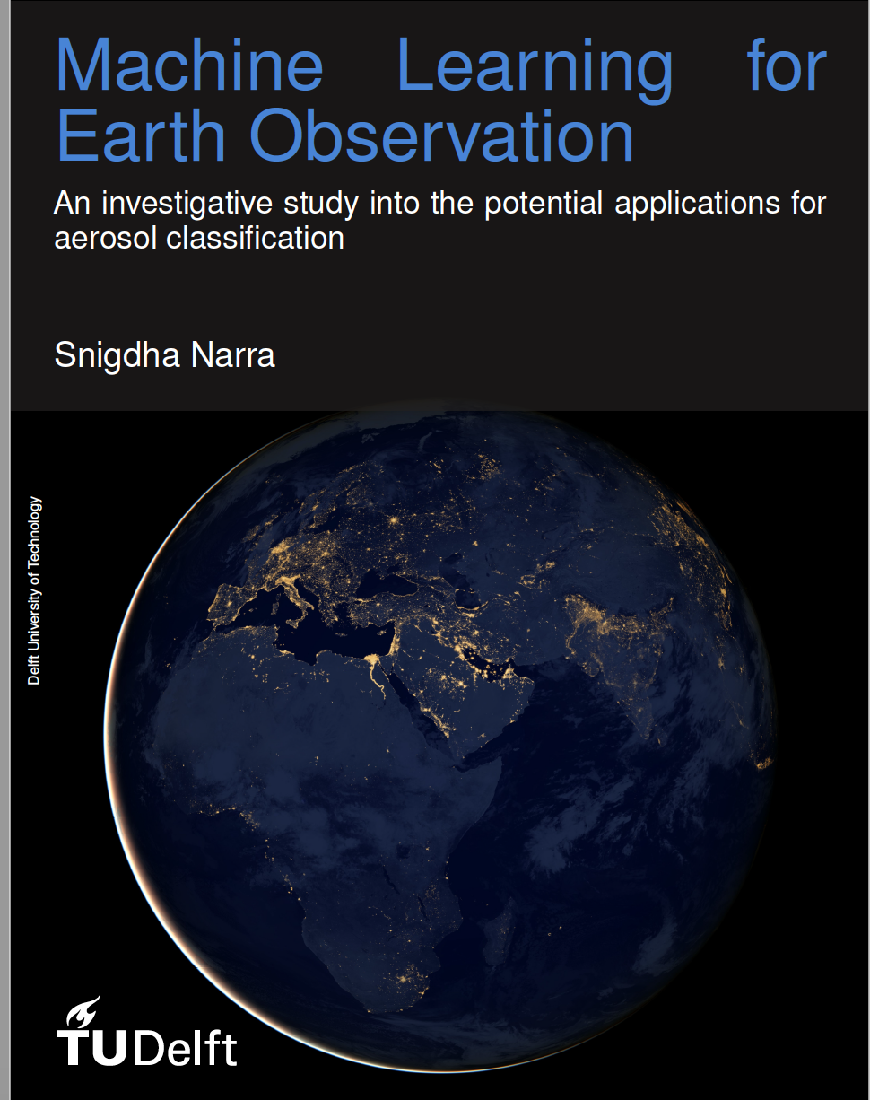
Investigating Machine Learning techniques for aerosol classification
Midterm-Review
Notes:
We have come a long way from October 4, 1957 when the first satellite Sputnik was launched. In a
little over 63 years, almost 8,900 satellites have been launched from all across the world. From this
astounding number to date, approximately 1,900 remain operational, continuously gathering science
data or providing the infrastructure for communication.
The advances in machine learning and cloud computing combined with the terabytes of data from the
Earth observation satellites opens up avenues for creating newer and variant data products of better accuracy,
modeled to the requirements of the customer. Google Earth Engine is a successful commercial
example of using satellite data coupled with large scale cloud computing services to provide customizable
user output in the field of Earth Observation[

Slide 2
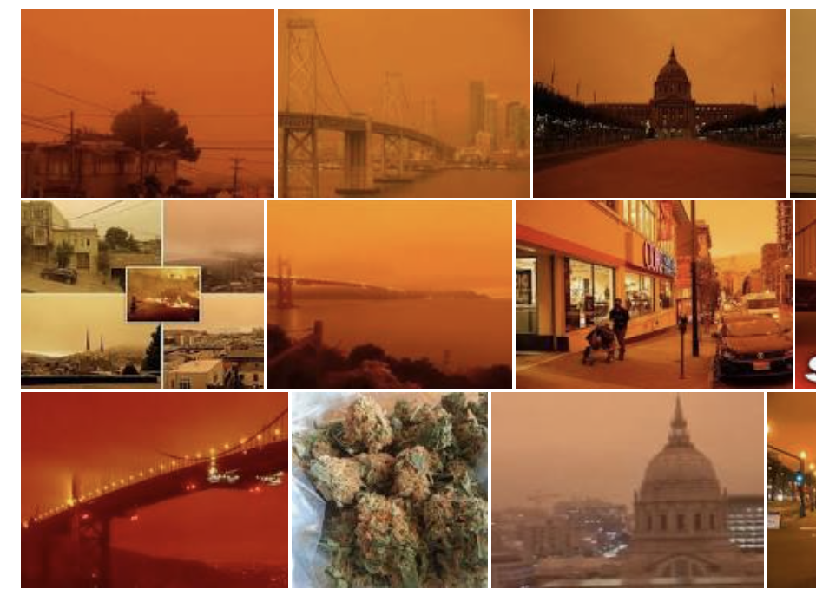
The Orange Sky in California

Slide 3
Importance of the work?
Why was the sky Orange in the Bay Area on 9th September 2020? There was smoke in the air from the Bear Fire near Chico, but the marine layer was protecting us, so the sky was red, yellow or orange even where air quality is good.
Notes:
What the Orange sky has in common is that the very

Slide 4
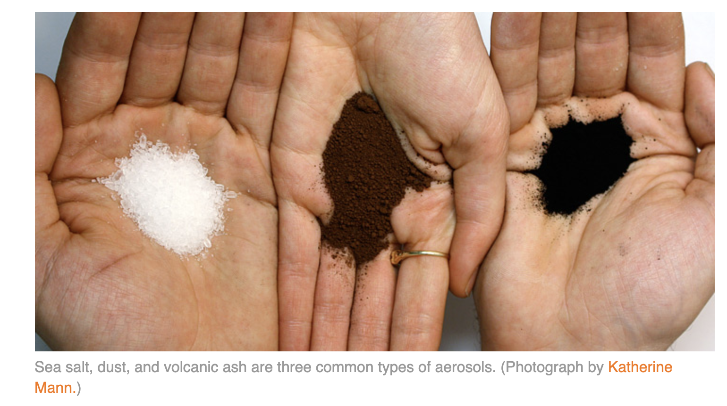
Aerosols

Slide 5
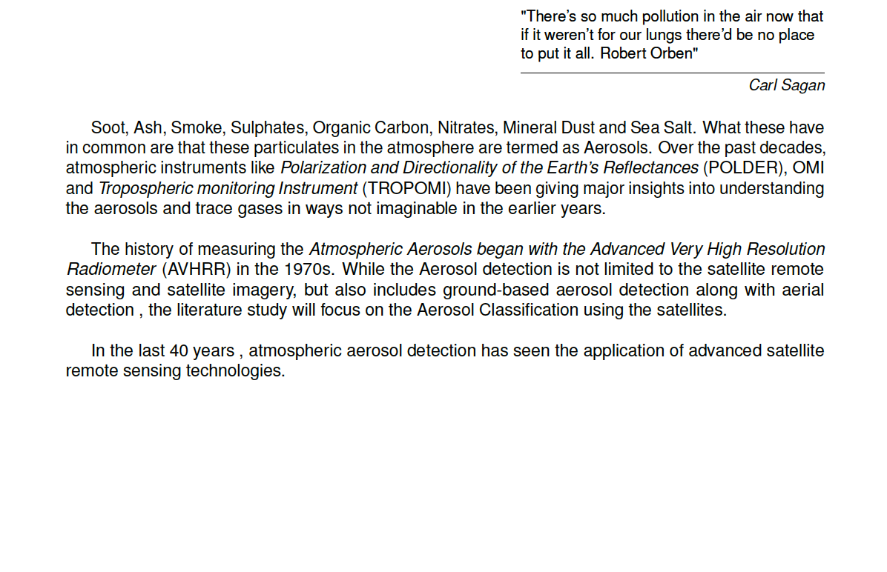
Aerosol Classification – Historical Background

Slide 6
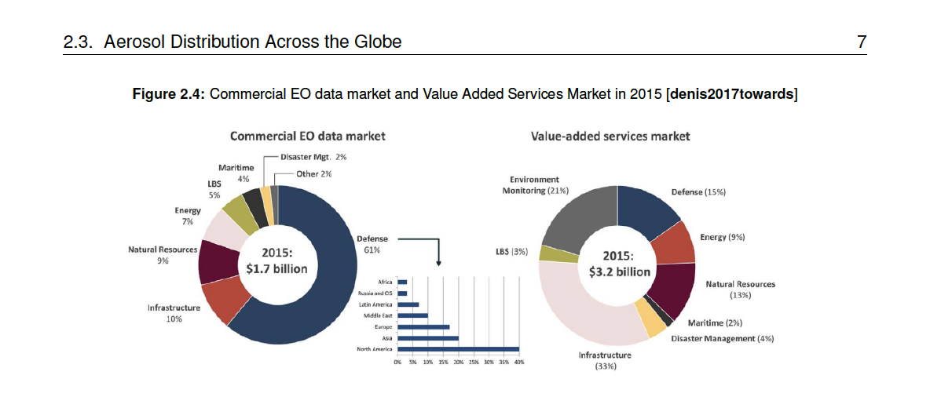
Application Area
Even as far back as 2015, the Commercial EO data market was worth 1.7 billion dollars with Value added
services market valued at 3.2 billion dollars. In 2025, this evaluation is estimated to increase
to 5.3 billion dollars [denis2017towards].
Of this nearly 21 percent as of 2015 was attributed to environmental
monitoring. From this evaluation, it is evident that there is increased interest in value-added
services market in Earth Observation. To meet that end, Machine Learning can help add value to the
satellite data by processing enormous data and detecting changing trends and classifying events on a global scale.
The satellites like the ones in the Copernicus program show the increasing relevance of properly handling the huge amount of Earth Observation data, quite common in remote sensing
This is further challenging if the processed data has to be provided in near real time (NRT), like the cloud product from TROPOMI/ Sentinel-5 precursor (S5P) or the upcoming Sentinel-4 (S4) mission.
Notes:
The investment and the market share of the air quality market shows a continually increasing trend over
the years and market research across multiple business analyst firms indicate a strong prevelance to
such improving trends in the future. In such a scenario investigating in the sources and types of aerosols
and to derive more insights into the satellite data to understand the prevelance of aerosols around us in
the air is a positive investment not only from an environmental, policy and health perspective but also
from the monetary prespective.

Slide 7
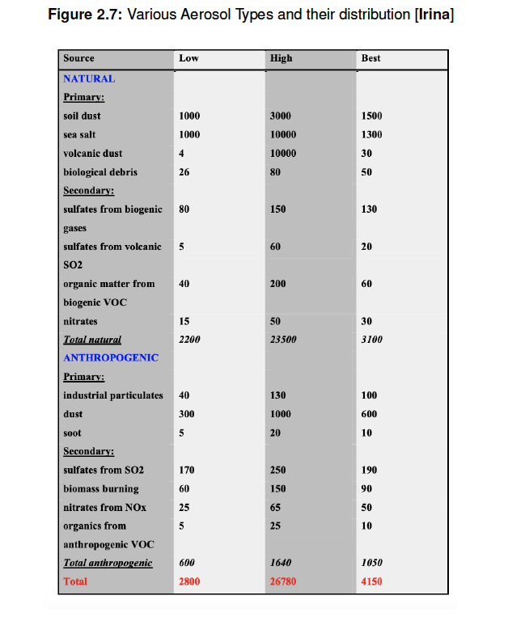
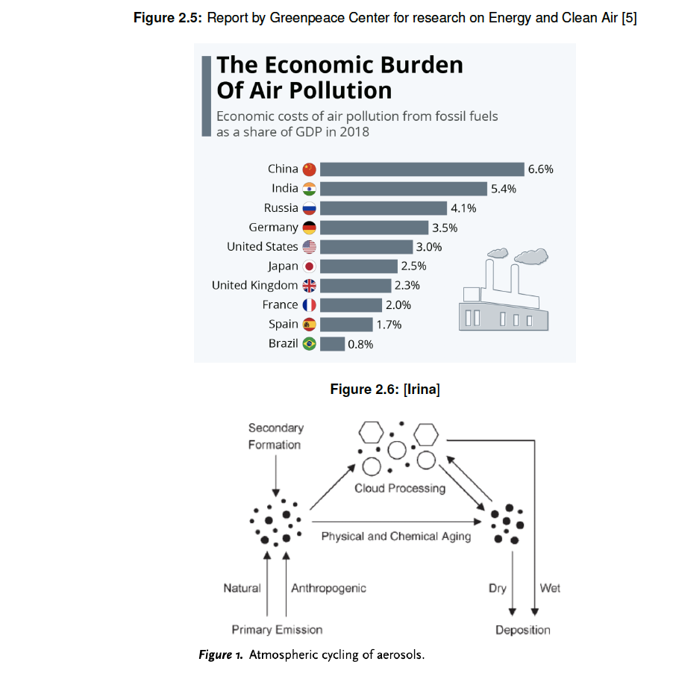
Aerosols Continued

Slide 8
Research Objective
The objective of the research is to investigate machine learning techniques for the purpose of Earth Observation, in specific the aerosol distribution.
The science output of this study would help identify the good and bad aerosols with regard to impact on human beings and help understand the combination of sources on a global scale.
The scope of the research project is as follows:
To classify the satellite data especially on atmospheric aerosols using Artificial Intelligence (AI)
method.
• To build an efficient model which perform better on the satellite aerosol retrievals.
• To optimise the classification accuracy of the aerosol models.
• To validate and compare the proposed model of machine learning method with traditional aerosol retrieval models in terms of classification accuracy.

Slide 9
Research Questions
The following are the research questions that will be answered through the research.
What is the classification accuracy of the machine learning algorithms Support Vector Machine
(SVM), KNN and Random Forest (RF) for aerosol classification?
• What are the past satellite missions that give information regarding the atmospheric aerosols?
• How can AI give a boost of classification on satellite data?
• Which algorithms have higher accuracy on the satellite aerosol retrievals
• Is it possible to build a higher accuracy model than that presently achieved aerosol classification
by the existing algorithms?
• How do the classification results of SVM, KNN and RF compare with each other?

Slide 10
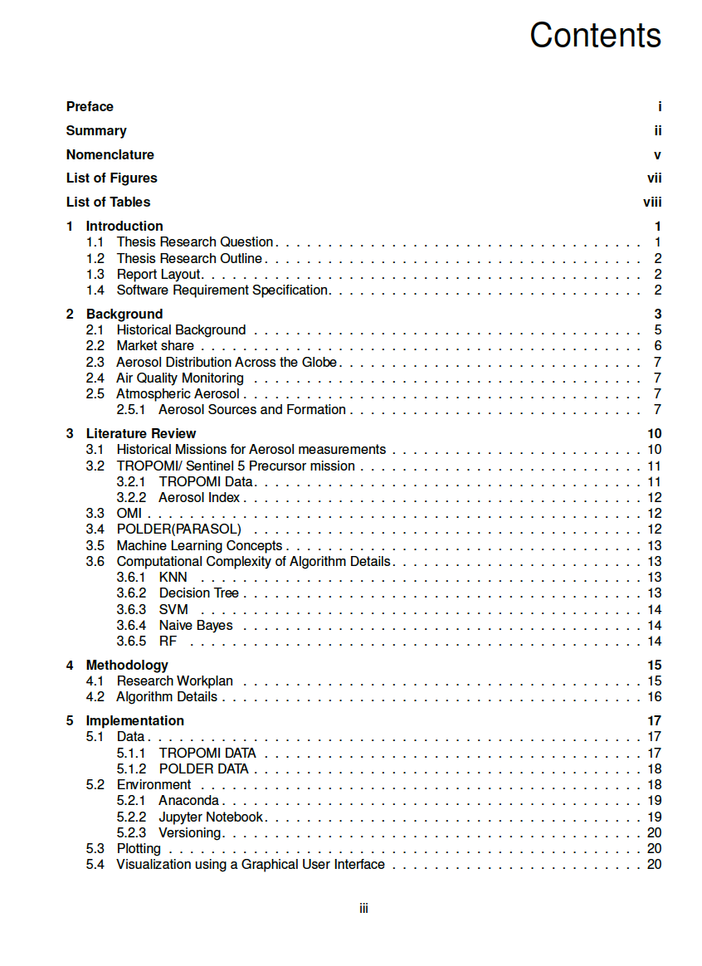
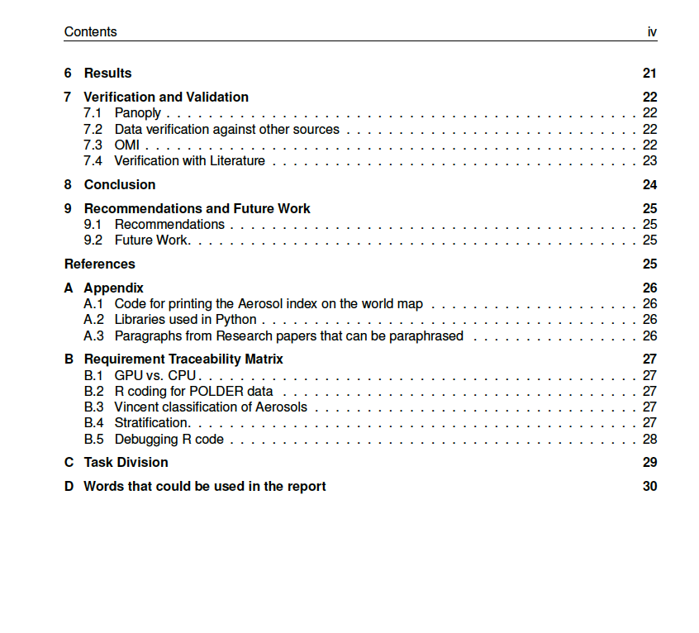
Contribution/ Table of Contents

Slide 11
Requirement Matrix
ReQ-ID | Requirement | SubCategory
R-001 | The application shall to a reasonable degree to accuracy be able to distinguish between alteast five major types of aerosols. | Application
R-002 | The application shall be capable to be deployed and tested on a computer with the specifications of 1.4 Ghz processor and 8 Gb RAM | Performance
R-003 | The application shall reach a performance metric of accuracy of atleast 90% on the test dataset | Performance
R-004 | The application shall use 60% of the data for training the dataset and 40% of the data for testing | Performance

Slide 12
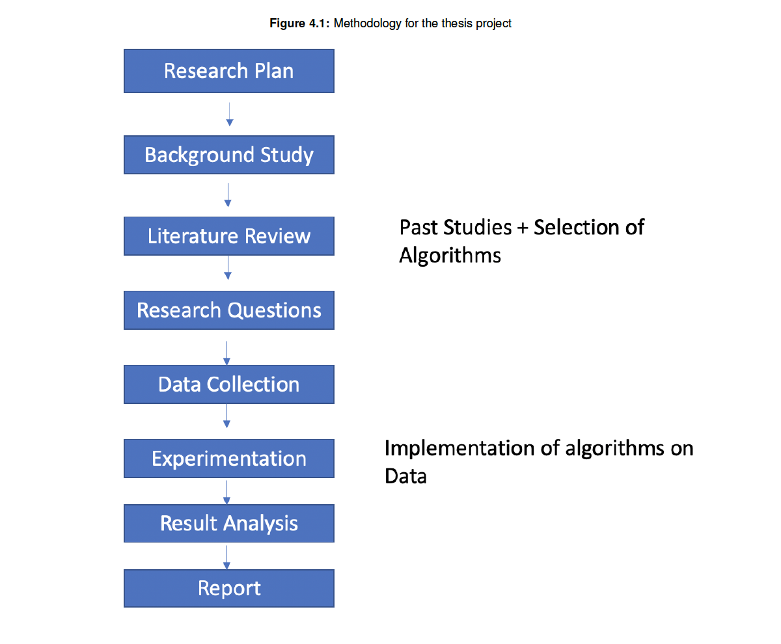
Methodology
Machine Learning algorithms investigation.
Notes:
Machine Learning is a method of data analysis that automates analytical model building. It is a branch of artificial intelligence based on the idea that systems can learn from data, identify patterns and make decisions with minimal human intervention.

Slide 13
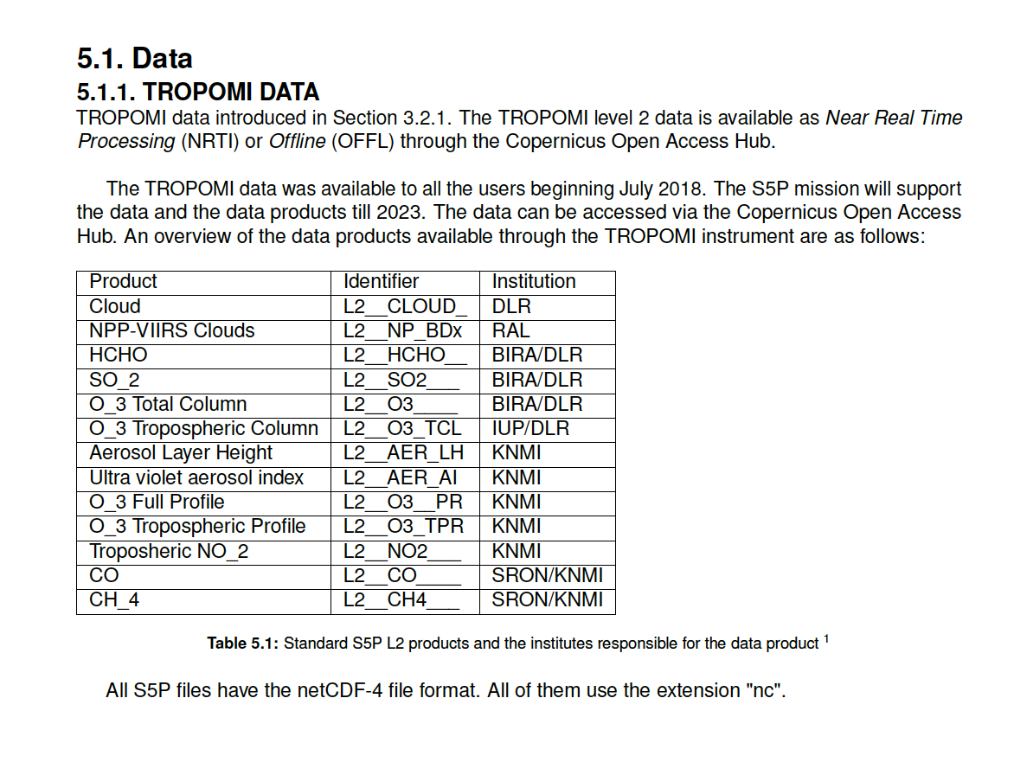
TROPOMI DATA

Slide 14
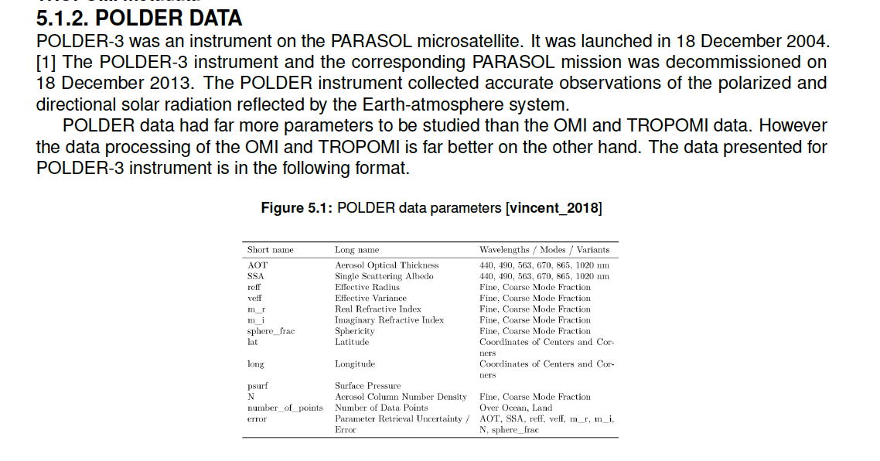
POLDER DATA

Slide 15
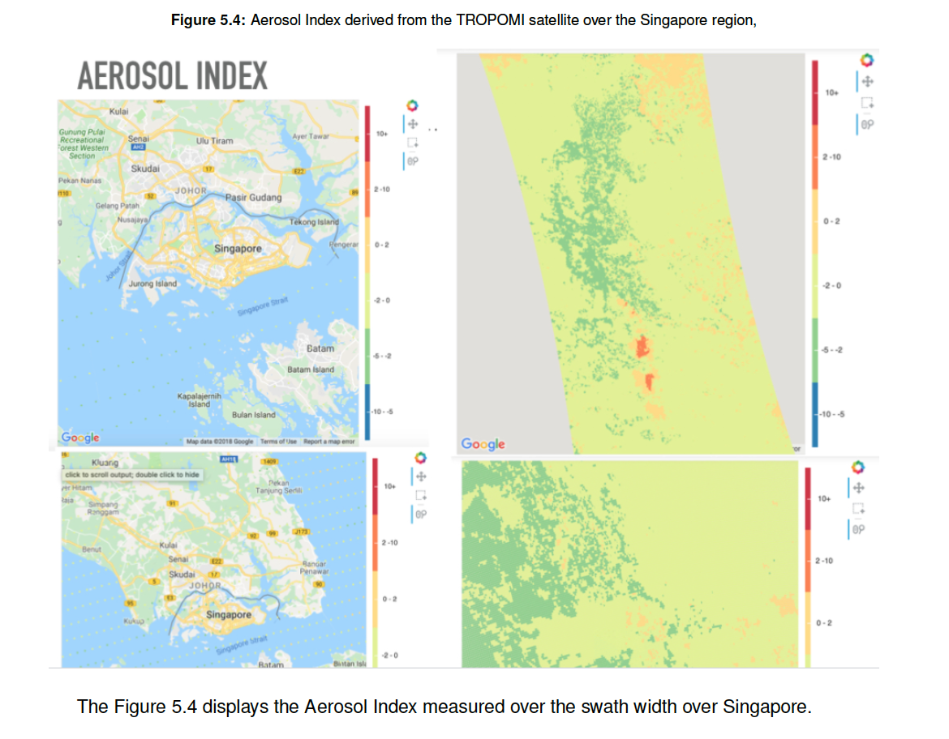
Aerosol Index

Slide 16
Validation
Panoply
Data verification against other sources (Literature sources)
OMI Data – overlap in timeline, some preclassified aerosols.

Slide 17
Future Scope
With better instruments and dedicated missions which provide data with more precision and higher cloud cover retrievals, the performance of the algorithm can be expected to be better. 3MI, a POLDER follow-on instrument to be launched in the 2020s has extended spectral range in the shortwave infrared
with enhanced capabilities for cloud retrieval 1.
To end, this is only the beginning of the era of machine learning in the field of Earth Observation,and there is much work to be done to fine tune the algorithm and input precise and larger datasets aimed at a targeted application at hand.
More data better algorithm?
Faster computing, faster implementation, better result?

Slide 18
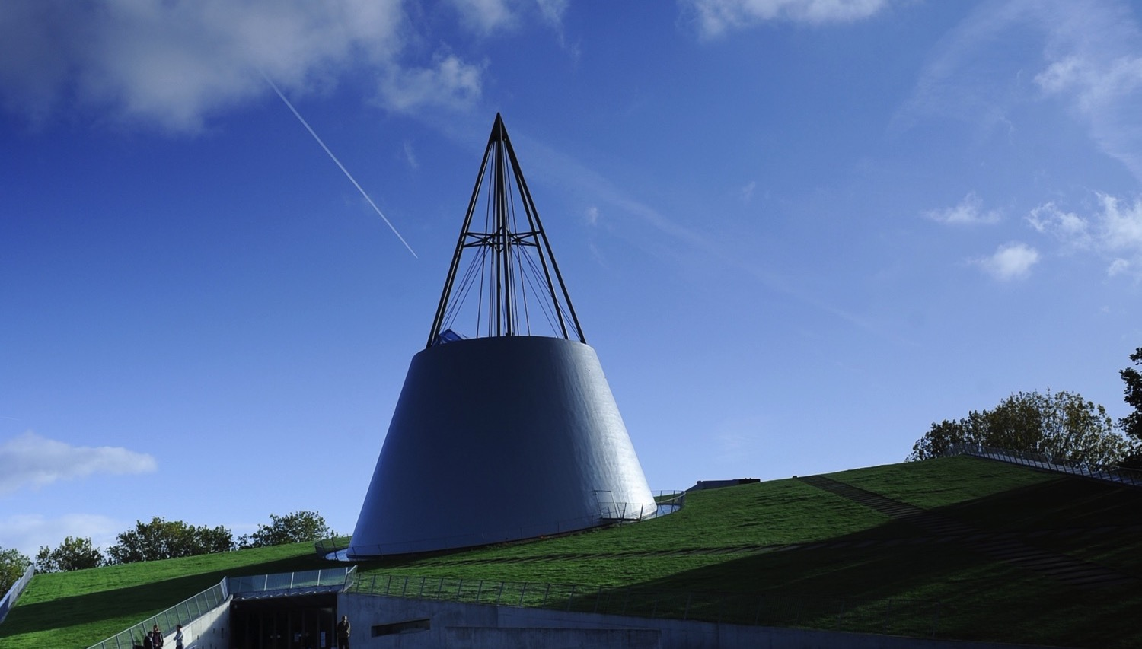
Appendix

Slide 19
Dates to remember
March – Midterm review
June – Greenlight
July – Defense

Slide 20
Thank You

Slide 21
Revisions – 28th January
Performance
Trade-Off
Review
Rationale
Req ID – Rationale Verification Method
Tracker – Yes or No is the answer
Dataset include in the requirements
Application + Performance + Dataset + Region
It should have no dependency – memoryless
Requirement / Problem definition

Slide 22
Meeting – 21 January 2021
Make the traceability matrix
Pollution services from the satellite data
Quick response
Error rate
Down to sensitivity
Accurate
Sand, Dust, Accurate
Real time Data
Remember the aim to not to push the application but to learn to write the thesis.

Slide 23
Meeting – 25 January 2021
Finalise the dates and the task list to work on the data.

Slide 24
Meeting – 28 January 2021
Performance
Trade-Off
Review
Rationale
Req ID – Rationale Verification Method
Tracker – Yes or No is the answer
Dataset include in the requirements
Application + Performance + Dataset + Region
It should have no dependency – memoryless
Requirement / Problem definition

Slide 25
Meeting – 4 February 2021
Version Control
Requirement
Conclusion- Requirement Matrix
Layout in the Introduction
How Computers See the Earth: A ML Approach to Understanding Satellite Imagery (Cloud Next '18)

Slide 26
Meeting – 11 February 2021
Made changes to the document
Synced Github account to the jupyter notebook

Slide 27
Meeting – 18 February 2021
Made revisions to the document
Made the document compatible with acronym

Slide 28
Gantt Chart
March 2021– Midterm review – BASIC CODE REVIEW, SKELETON OF THE REPORT
June 2021– Greenlight
July 2021– Defense

